Slide 1
Windows Files Introduction
for
Windows Files Worksheet

Slide 2
Windows File Name Format
myFile.txt
File Name
User defined
Should reflect the purpose or contents of the file
May be any string
Some limitations on length / special characters
Separator
System defined
Must be a period
File Extension
Application and System defined
Usually 3 or 4 characters
Identifies the application use to open or edit the file

Slide 3
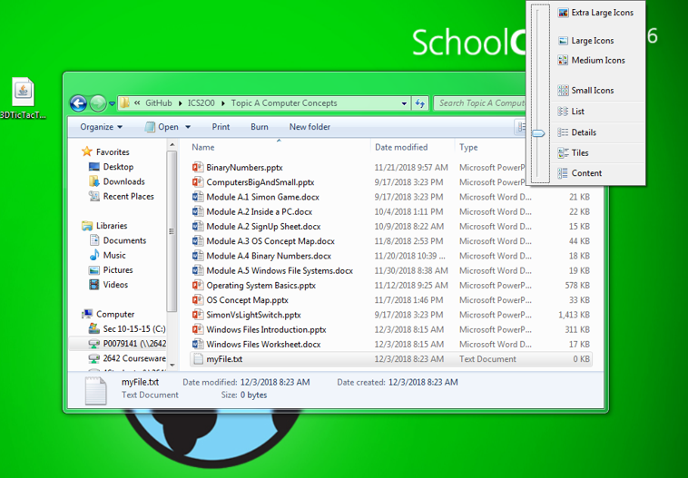
Setting “View File Extensions”

Slide 4
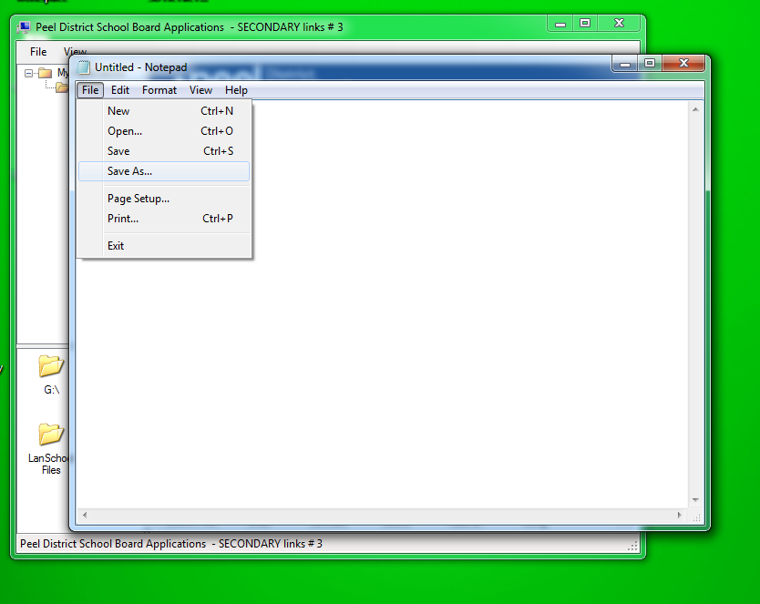
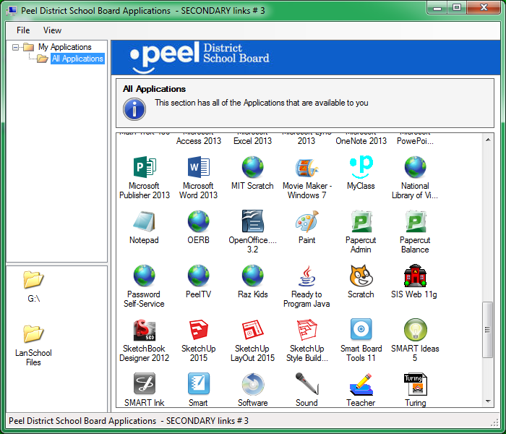
Opening a Text File (When Right-Click does not work)
Open Notepad
Use File => Save As…
(Note: Remember the folder where you saved the file!)

Slide 5
Windows File Path Format
C:\Documents\myFile.txt
Folder Name(s)
User defined
Should reflect the purpose or contents of the Folder
May be any string
Some limitations on length / special characters
NOTE: Multiple Folders may be listed to form a path
Folders are separated by “\” or “/”
File Name
See previous slides
Drive Letter
System defined*
Refers to the disk drive or device storing the file
May be any letter A to Z
Always includes “:\”

Slide 6
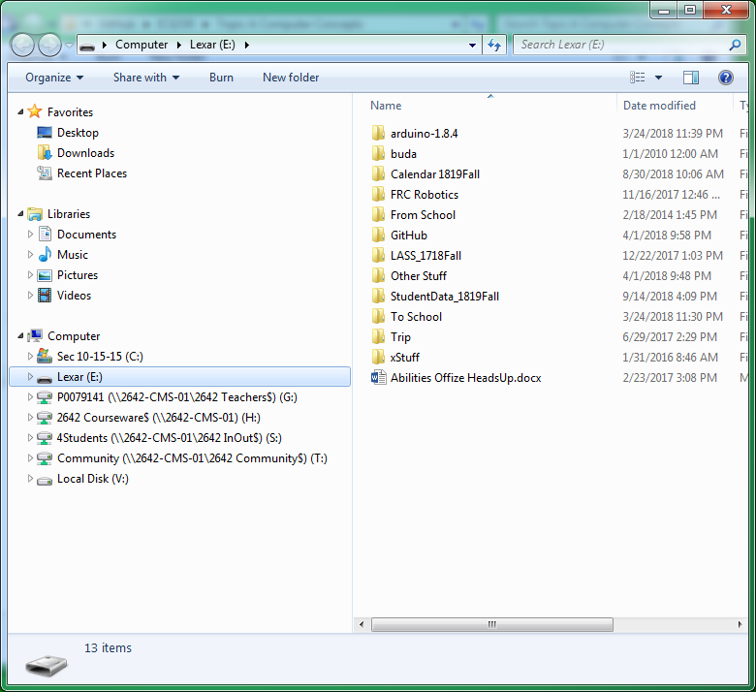
Attached Disks & Devices (Using Windows File Explorer)
All disks and attached file devices are listed here.
Disks C and V are HDD disks attached directly to the computer
Disk E is a USB memory stick
The other disks are attached through the school network
The network path is shown in the file name
LASS is school number 2642

Slide 7
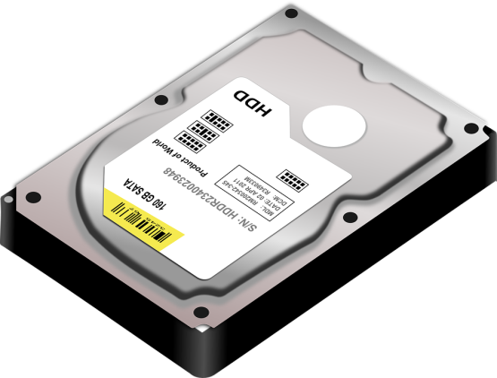
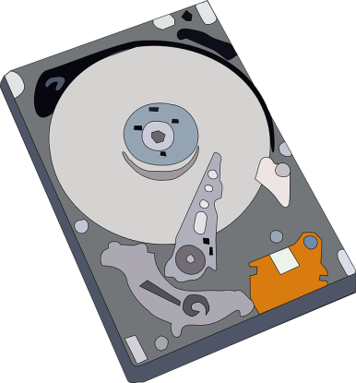
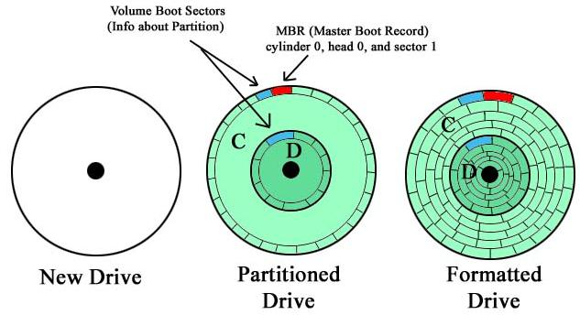
Windows Disk Partitions
The storage space on a single physical Hard Disk Device may be partitioned (sub-divided ) into a number of logical drives
Each logical drive has a unique drive letter and operates as a separate device.
The size of the logical drives is smaller than the original physical drive.
Drives may also have a MBR Boot Partition
The MBR is hidden from users (does not have a drive letter)
The MBR contains critical configuration information for starting up Windows
The MBR is a frequent target of virus malware.

Slide 8
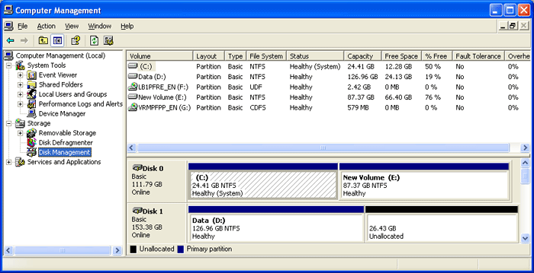
Windows Disk Partitions
Some advantages of using disk partitions include:
Separation of user data from system and application files for improved security and file permission and access management.
Separation of user data from system and application files to ensure that users are prevented from using too much memory that could impact system performance.
Improved efficiency related to the way Windows uses disk drive memory.

